Slide 1
Dynamic Polymorphism

Slide 2
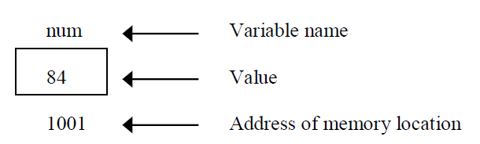
Pointers
Pointer is a variable which can hold the address of a memory location rather than the value at the location.
Consider the following statement
int num =84;

Slide 3
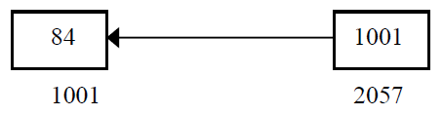
we can access the value of num by the variable ptr.

Slide 4
Pointer to objects
Pointers can be defined in case of base C++ variables so also pointers can be defined for an object type. For example
class A
{
int x,y;
public:
void get();
void display();
};
A *abc //pointer to class A

Slide 5
Pointers to members
A class member pointer can be declared using the operator :: * with the class name.
For Example:
int A::*ptr=&A::m //data member
void (A::*ptr)(void)=&A::input; //member function
We can also design pointers to member functions which ,then can be invoked using the deferencing operator in the main as shown below.
(object-name.* pointer-to-member function)
(pointer-to -object -> * pointer-to-member function)

Slide 6
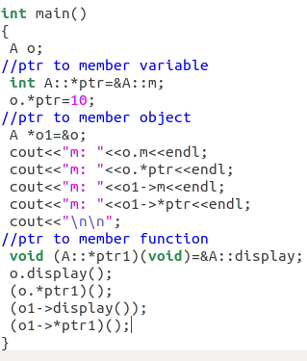
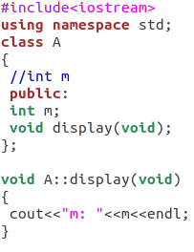
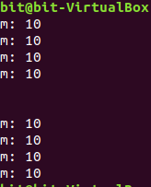

Slide 7
Pointers to derived class
We can use pointers not only to the base objects but also to the objects of derived classes.
Pointers to objects of a base class are type-compatible with pointers to objects of a derived class.
With base class pointer, we can access the public members of the derived class, only those members which are inherited from base class and not the members that originally belong to derived class.

Slide 8
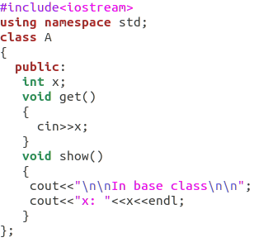
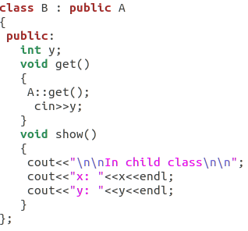
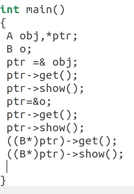

Slide 9
Virtual Function
A virtual function is a member function which is declared within a base class and is re-defined(Overridden) by a derived class. When you refer to a derived class object using a pointer or a reference to the base class, you can call a virtual function for that object and execute the derived class’s version of the function.

Slide 10
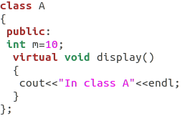
To make a member function virtual, the keyword virtual is used in the methods while it is declared in the class definition but not in the member function definition.
For example:

Slide 11
Rules for Virtual Function
The virtual functions must be members of some class.
They cannot be static members.
They are accessed by using object pointers.
We can not have virtual construction.
The keyword virtual should not be repeated in the definition if the definition occurs outside the class declaration.

Slide 12
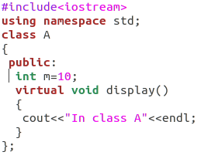
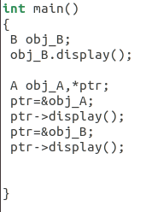
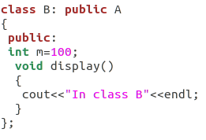

Slide 13
Pure Virtual Functions

Slide 14
Pure Virtual Function
A pure virtual function is a function that has the notation "= 0" in the declaration of that function.
Ex.
class SomeClass
{
public: virtual void pure_virtual() = 0;
};

Slide 15
The pure specifier
The "= 0" portion of a pure virtual function is also known as the pure specifier, because it’s what makes a pure virtual function “pure”.
Pure specifier appended to the end of the virtual function definition may look like the function is being assigned a value of 0, that is not true.
The notation "= 0" is just there to indicate that the virtual function is a pure virtual function, and that the function has no body or definition.

Slide 16
Abstract Classes
A class with one or more pure virtual functions is an Abstract Class
Objects of abstract class can’t be created
Abstract Class is a class which contains atleast one Pure Virtual function in it.
Abstract classes are used to provide an Interface for its sub classes.
Classes inheriting an Abstract Class must provide definition to the pure virtual function, otherwise they will also become abstract class.
Pointer of abstract class can hold address of derived class

Slide 17
Simple Example
Math Symbol Problem
Create an abstract class MathSymbol may provide a pure virtual function doOperation(), and create two more classes Plus and Minus implement doOperation() to provide concrete implementations of addition in Plus class and subtraction in Minus class.
17

Slide 18
Algorithm for Math Symbol Problem
Create Mathsymbol abstract class with doOperation() pure virtual function.
Create plus class derived from Mathsymbol.
Create minus class dervied from Mathsymbol.
Perform addition in plus class using doOperation() pure virtual function.
Perform subtraction in minus class using doOperation() pure virtual function.
Print each values in respective classes.
18

Slide 19
Example
Some classes exist logically but not physically.
Example : Mathsymbol
Mathssymbol makes sense only as a base of some classes derived from it. Serves as a “category”
Hence instantiation of such a class must be prevented
class Mathsymbol //Abstract
{ public : //Pure virtual Function virtual void doOperation() = 0;
}
Mathsymbol M; // error : variable of an abstract class
Notes:
19

Slide 20
A pure virtual function not defined in the derived class remains a pure virtual function.
Hence derived class also becomes abstract
class Plus : public Mathsymbol{ //No doOperation() - Abstract public : void print(){ cout << “Doing Addition” << endl; }
class Minus : public Mathsymbol { public : void doOperation(){ // Override Mathsymbol:: doOperation() int a=10,b=5;
cout << “Subtration is = ” <<a-b<< endl; }
Minus m; // Valid
Plus p; // error : variable of an abstract class
Notes:
20

Slide 21
It is still possible to provide definition of a pure virtual function in the base class
The class still remains abstract and functions must be redefined in the derived classes, but a common piece of code can be kept there to facilitate reuse
In this case, they can not be declared inline
class Mathsymbol { //Abstract public : virtual void doOperation() = 0;
}; // OK, not defined inline
void Mathsymbol::doOperation(){ cout << “Arithmetic" << endl; }
class Minus : public Mathsymbol
{ public : void doOperation(){ Mathsymbol::doOperation(); //Reuse cout <<“Subtraction”<< endl; }
21
Notes:
21

Slide 22
